Slide 1


Streamline Logistic Solution
By Faith Ejele

Slide 2
Optimizing Order Fufillment
A Data Driven approach to eliminate backlogs with excel interactive dashboard

Slide 3
Introduction
In the fast-paced world of logistics, staying focused on set goals is key to success. A performance dashboard can provide valuable insights into total orders, average delivery times by route, zones, and customer feedback distribution. These solutions aim to streamline operations, improve delivery efficiency, and enhance customer satisfaction by ensuring timely product shipments

Slide 4
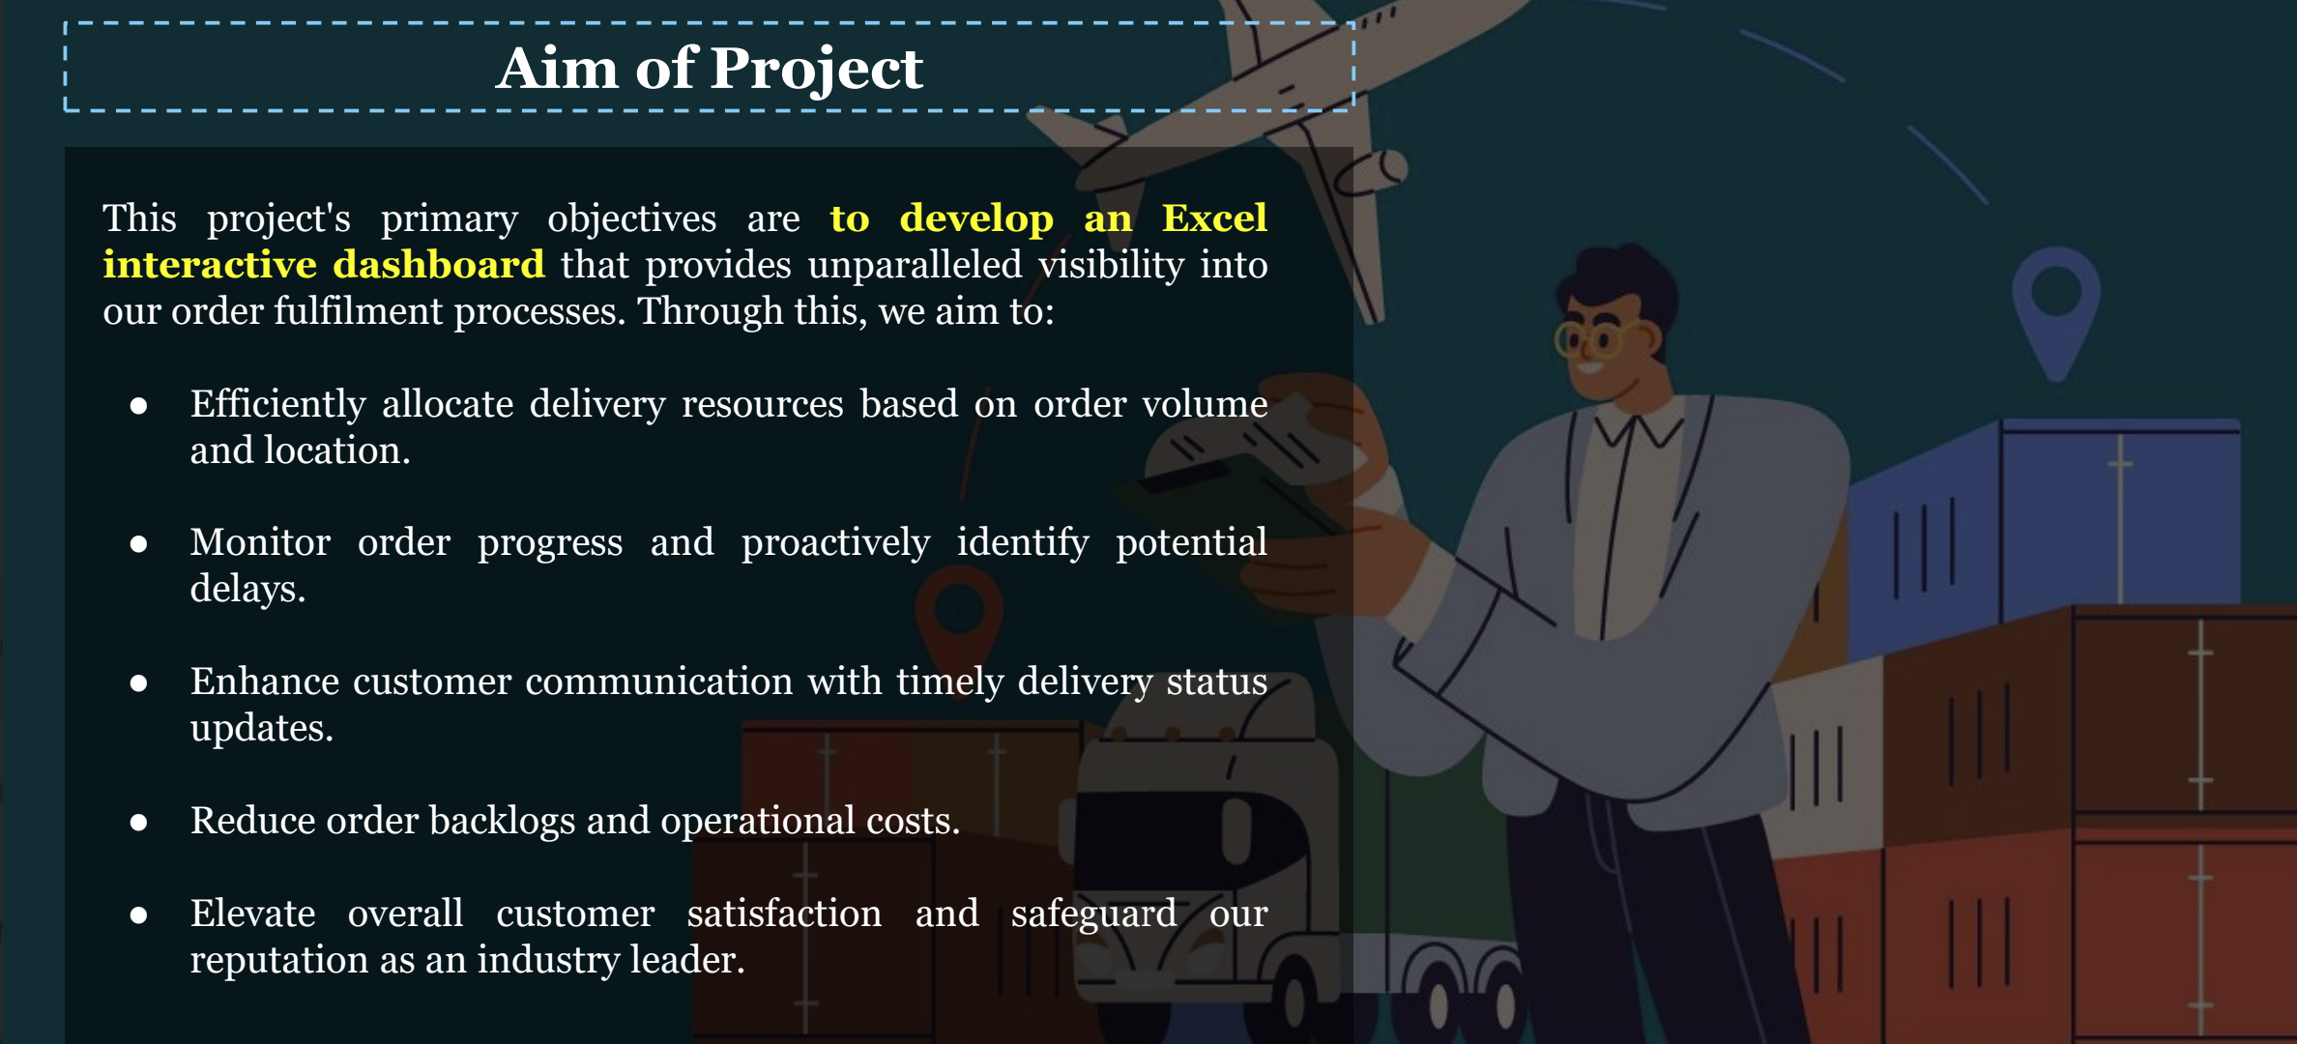

Slide 5
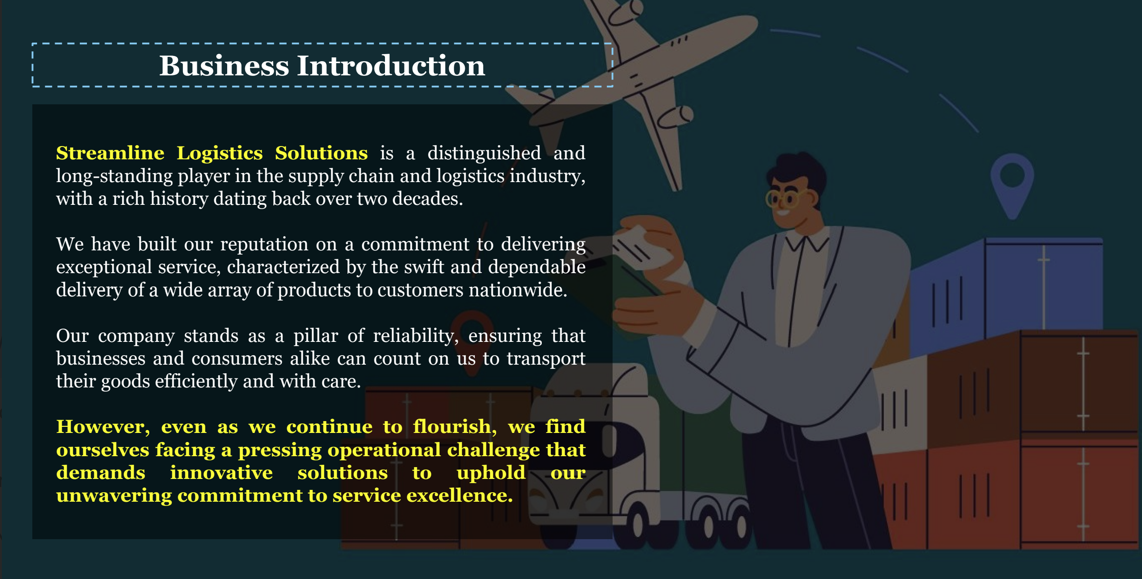

Slide 6
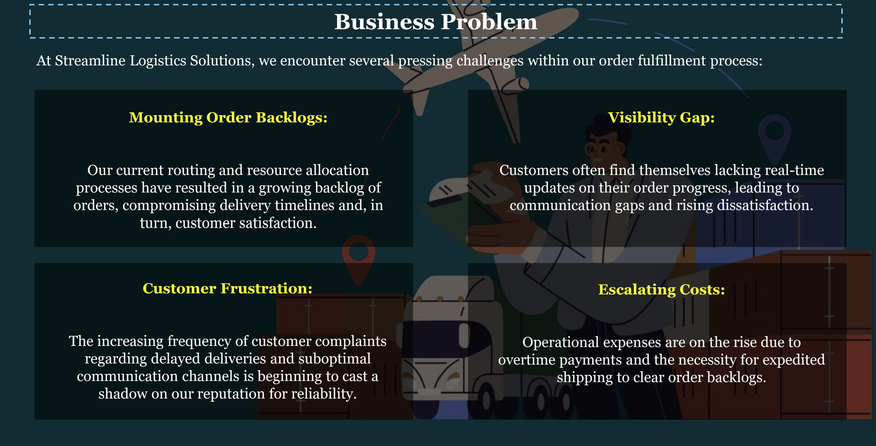

Slide 7
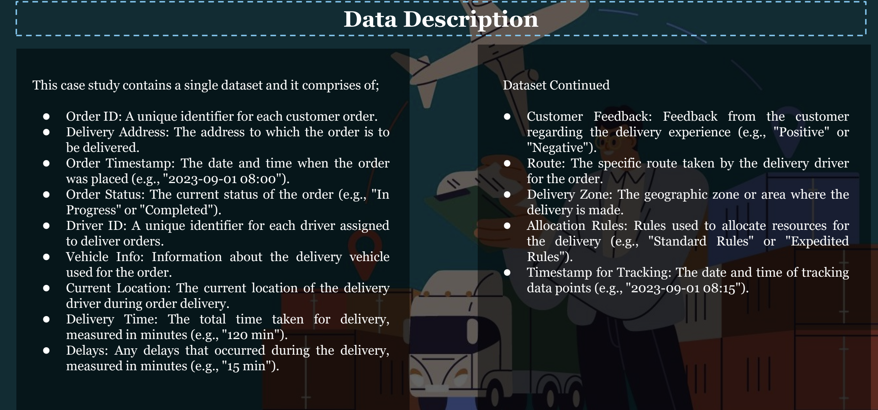

Slide 8
Steps Taken
Data was collected, cleaned and formatted.
New columns was added to the Data- Order Year, Month, Day, Hour –This was done to ascertain the delivery time of the order to the customer
Total orders from DashBoard is 1500, with a backlog of 767 in progress and 733 completed.
Pivot table was used with chart generated to analyse the Route, zone by the Delayed time in (mins)
Overview Dashboard was created for stakeholders to understand the Average time taken for delivery in different regions (Zone1, Zone2,Zone3)

Slide 9
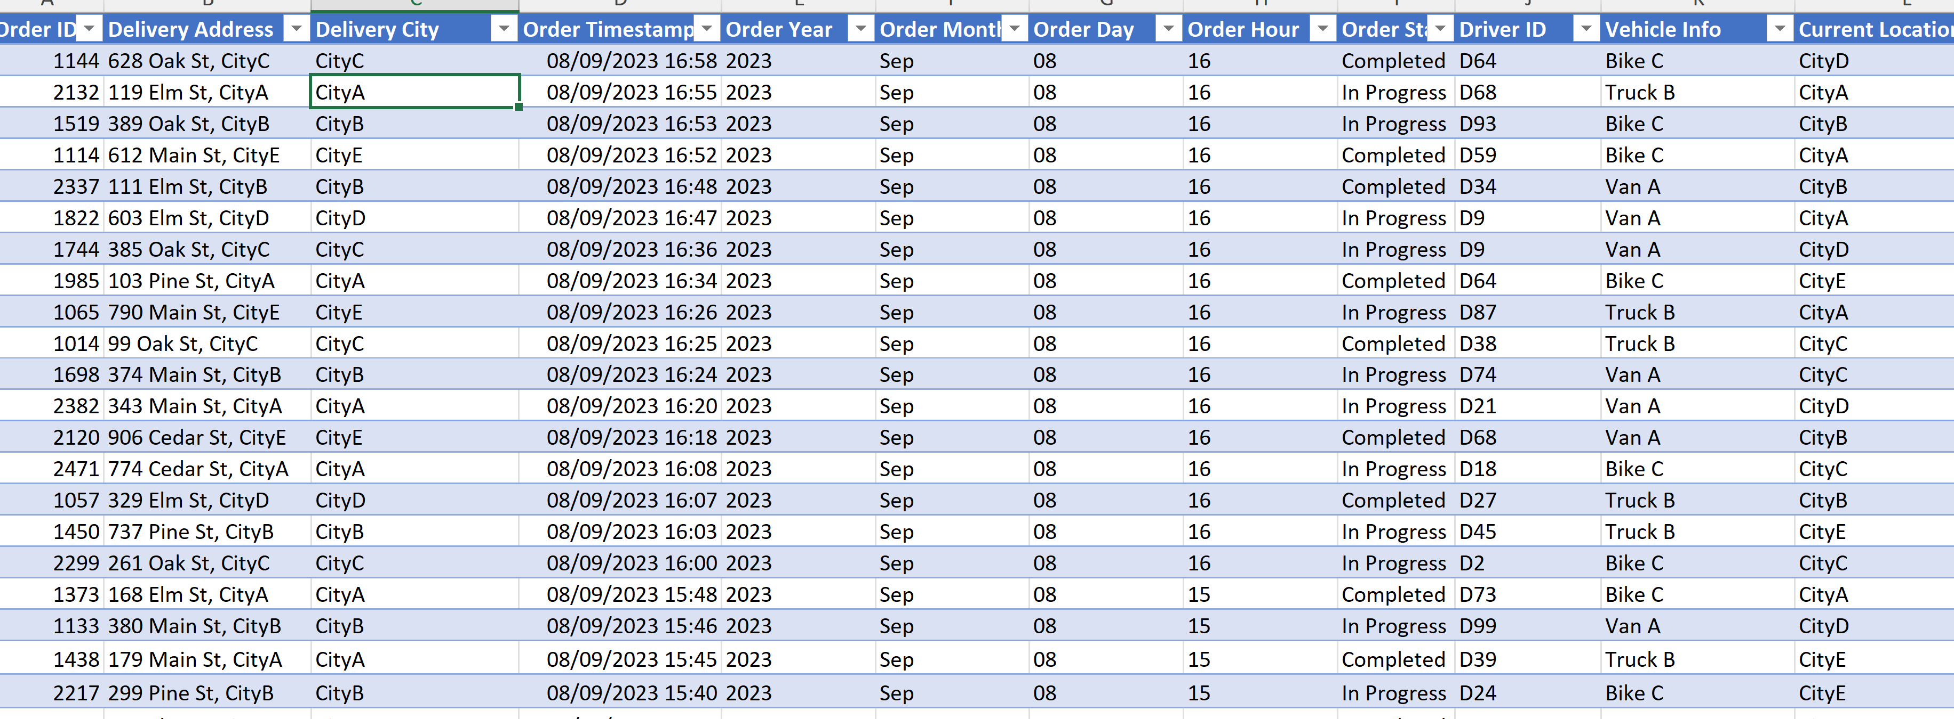
Excel Table

Slide 10
Chart –Average Delay to Delivery City

Slide 11
DASHBOARD OVERVIEW

Slide 12
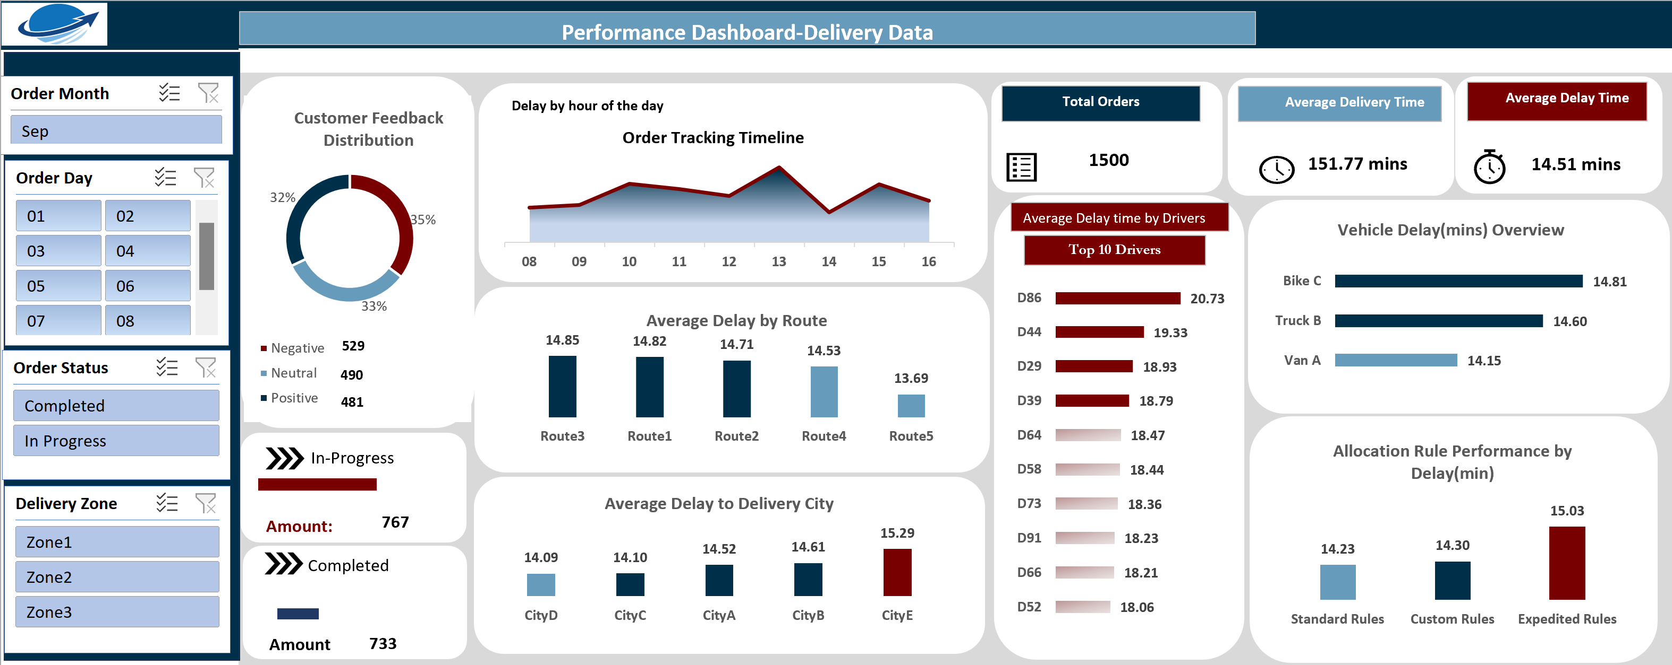

Slide 13
Interactive Dashboard-Order Day 2

Slide 14
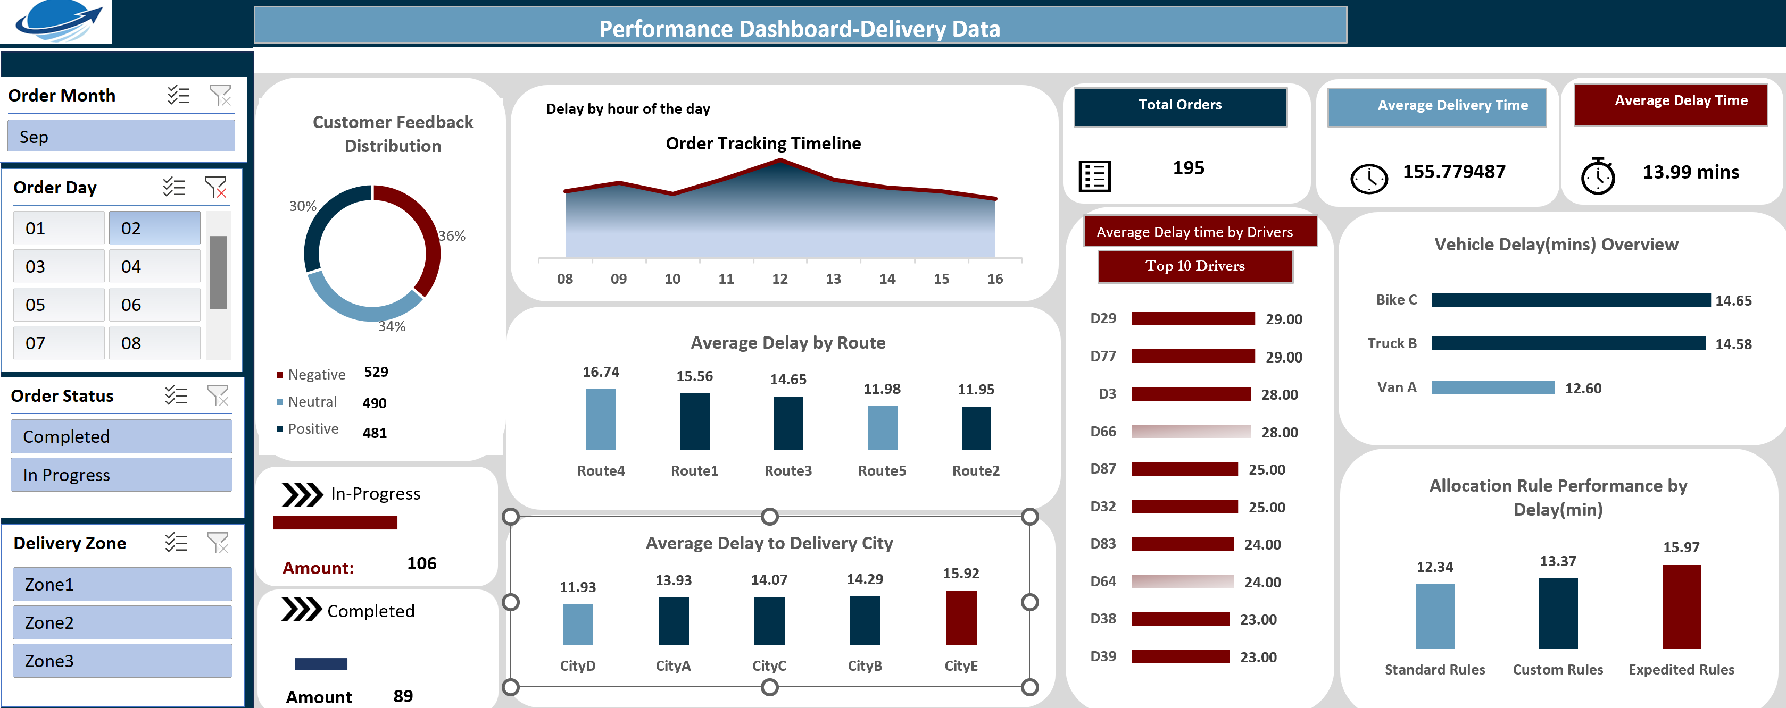

Slide 15
Summary of Insights to Streamline Logistic Solution
Data Collection
Data Cleaning
Data Preprocessing
Data Exploration
Data Visualization
Data Analysis
Insights
Recommendation

Slide 16
Problem
Order backlog issue
Delivery delays
Feedback and delays
Low performance of drivers to delivery location
Route delay as a result of traffic or long distances

Slide 17
Recommendations
Resource Allocation- more resources should be allocated to improve backlog orders.
Effective communication should be offered to customers.
Training of drivers to learn better route to deliver orders to customers
To tackle delays effectively and ensure smooth operations, consider the following logistic solutions: Route and Traffic Optimization: Utilize GPS and mapping tools to optimize routes and avoid congested areas, enhancing productivity.

Slide 18
Recommendation Contd….
Real-Time Shipment Updates: Implement a traffic system for instant updates on shipments, allowing for proactive adjustments.
Backup Transport Availability: In case of vehicle breakdowns, ensure immediate access to backup transport to maintain smooth delivery schedules.

Slide 19
Thank you

